Slide 1
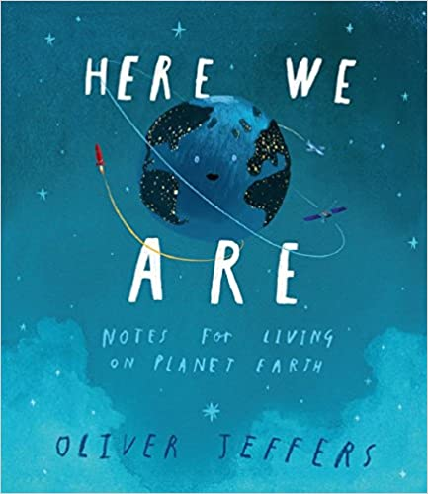



Pembridge ‘mini’ Earthshot Competition

Slide 2

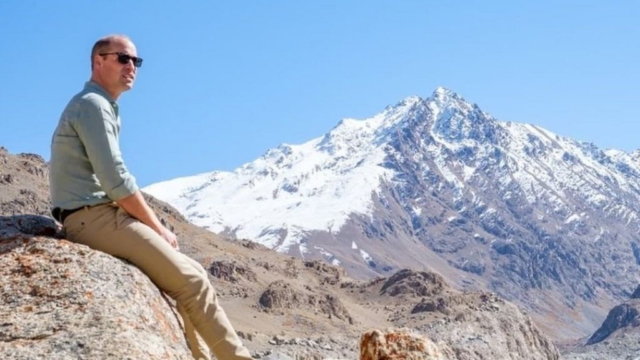
The Earthshot competition was set up by Prince William.
Play the video link to see Prince William explain the Earthshot Prize:
https://www.bbc.co.uk/newsround/54463164

Slide 3
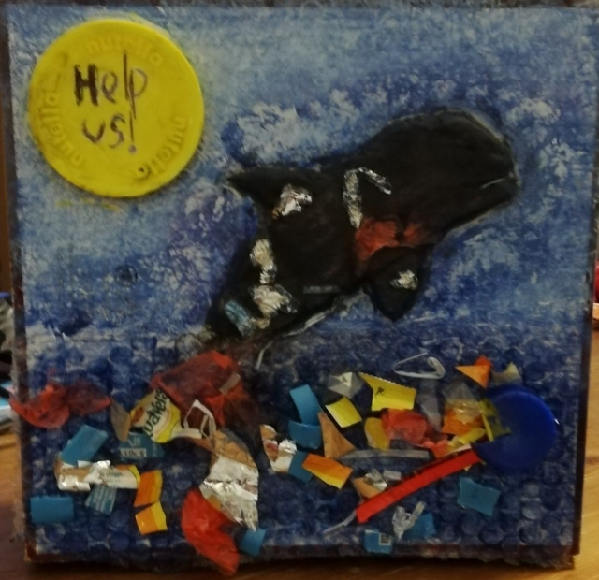
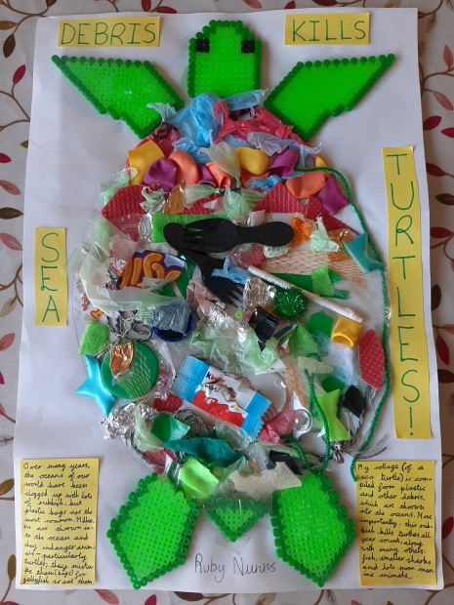
We are running our own
Pembridge ‘mini’ Earthshot competition
You will need to design a model, poster or picture that links to one of the Earthshots:
Clean Our Air
Protect and Restore Nature
Revive Our Oceans
Build a Waste-Free World
Fix Our Climate
I
Remember to include an environmental message to inspire others to look after our Earth.

Slide 4
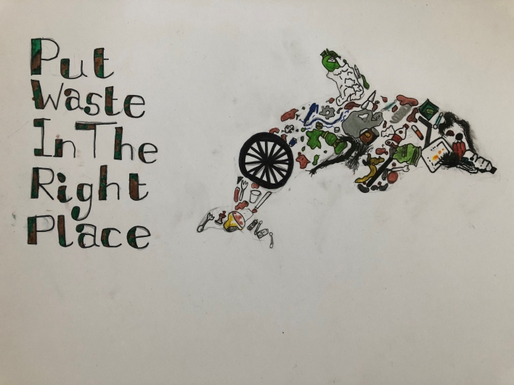
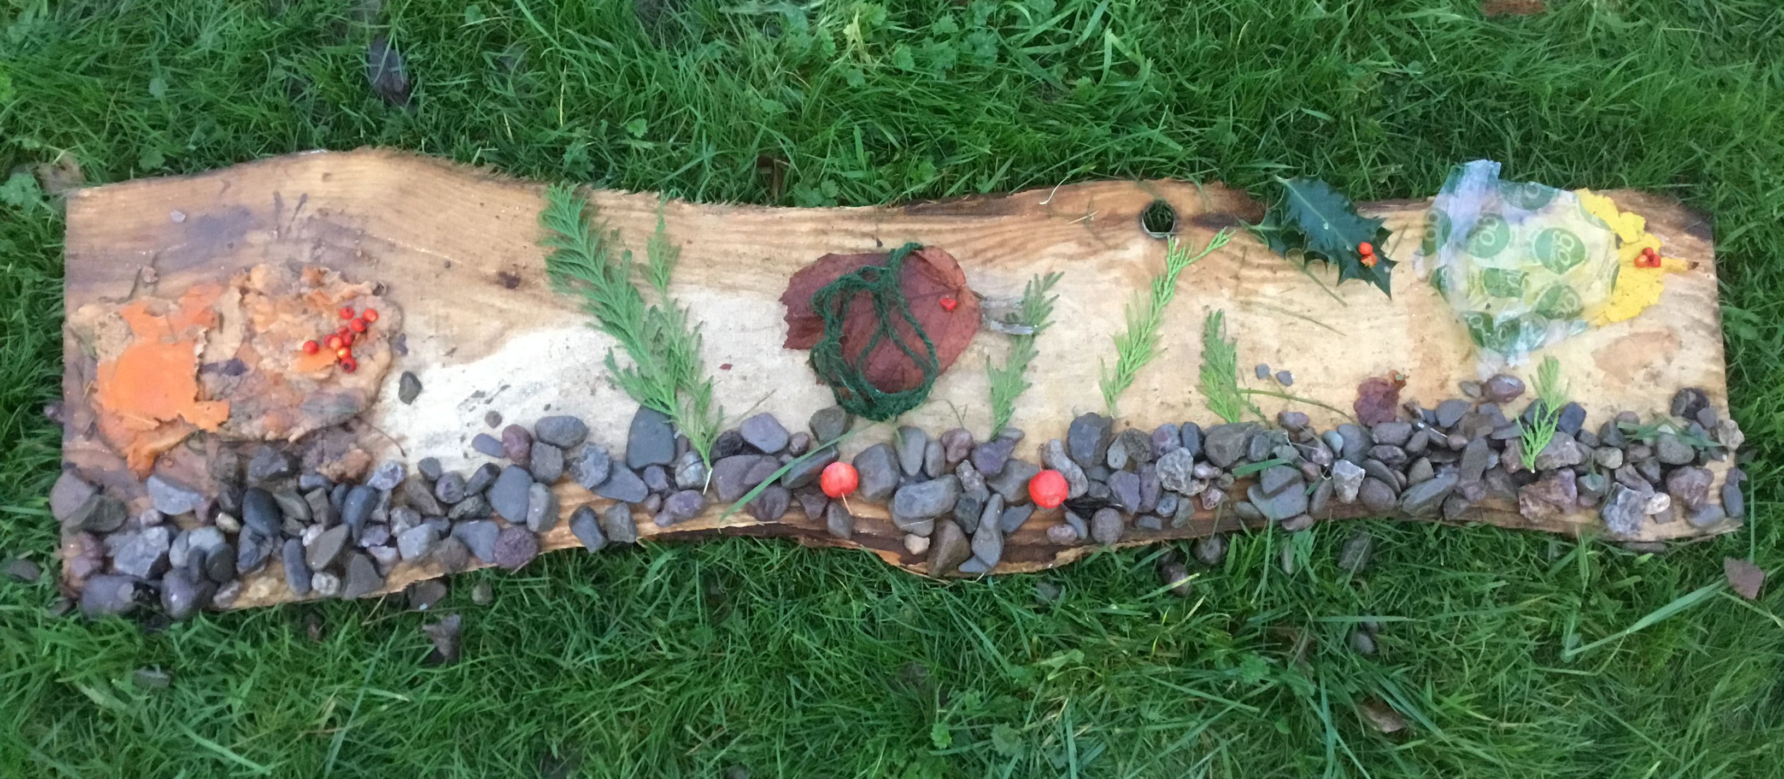
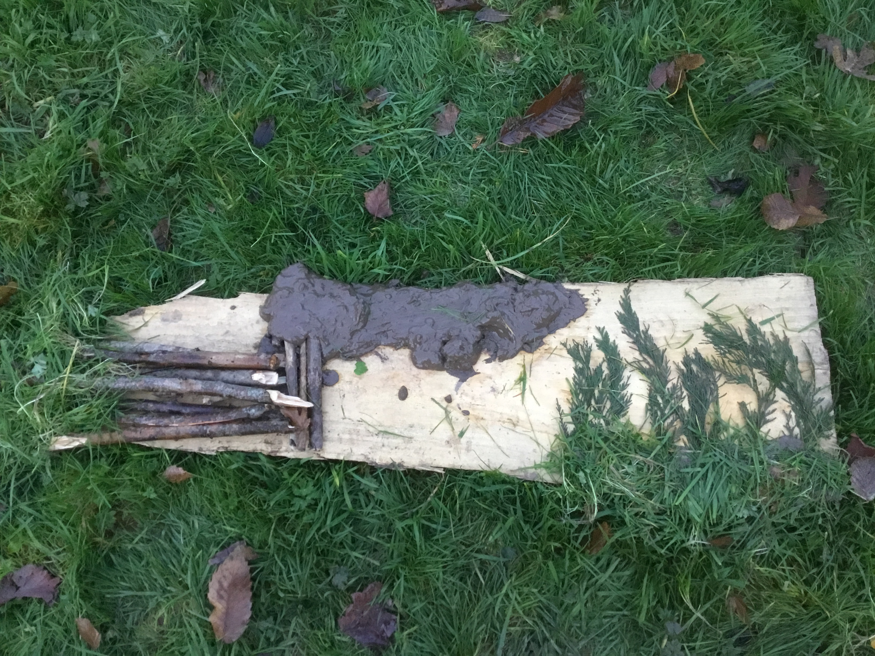
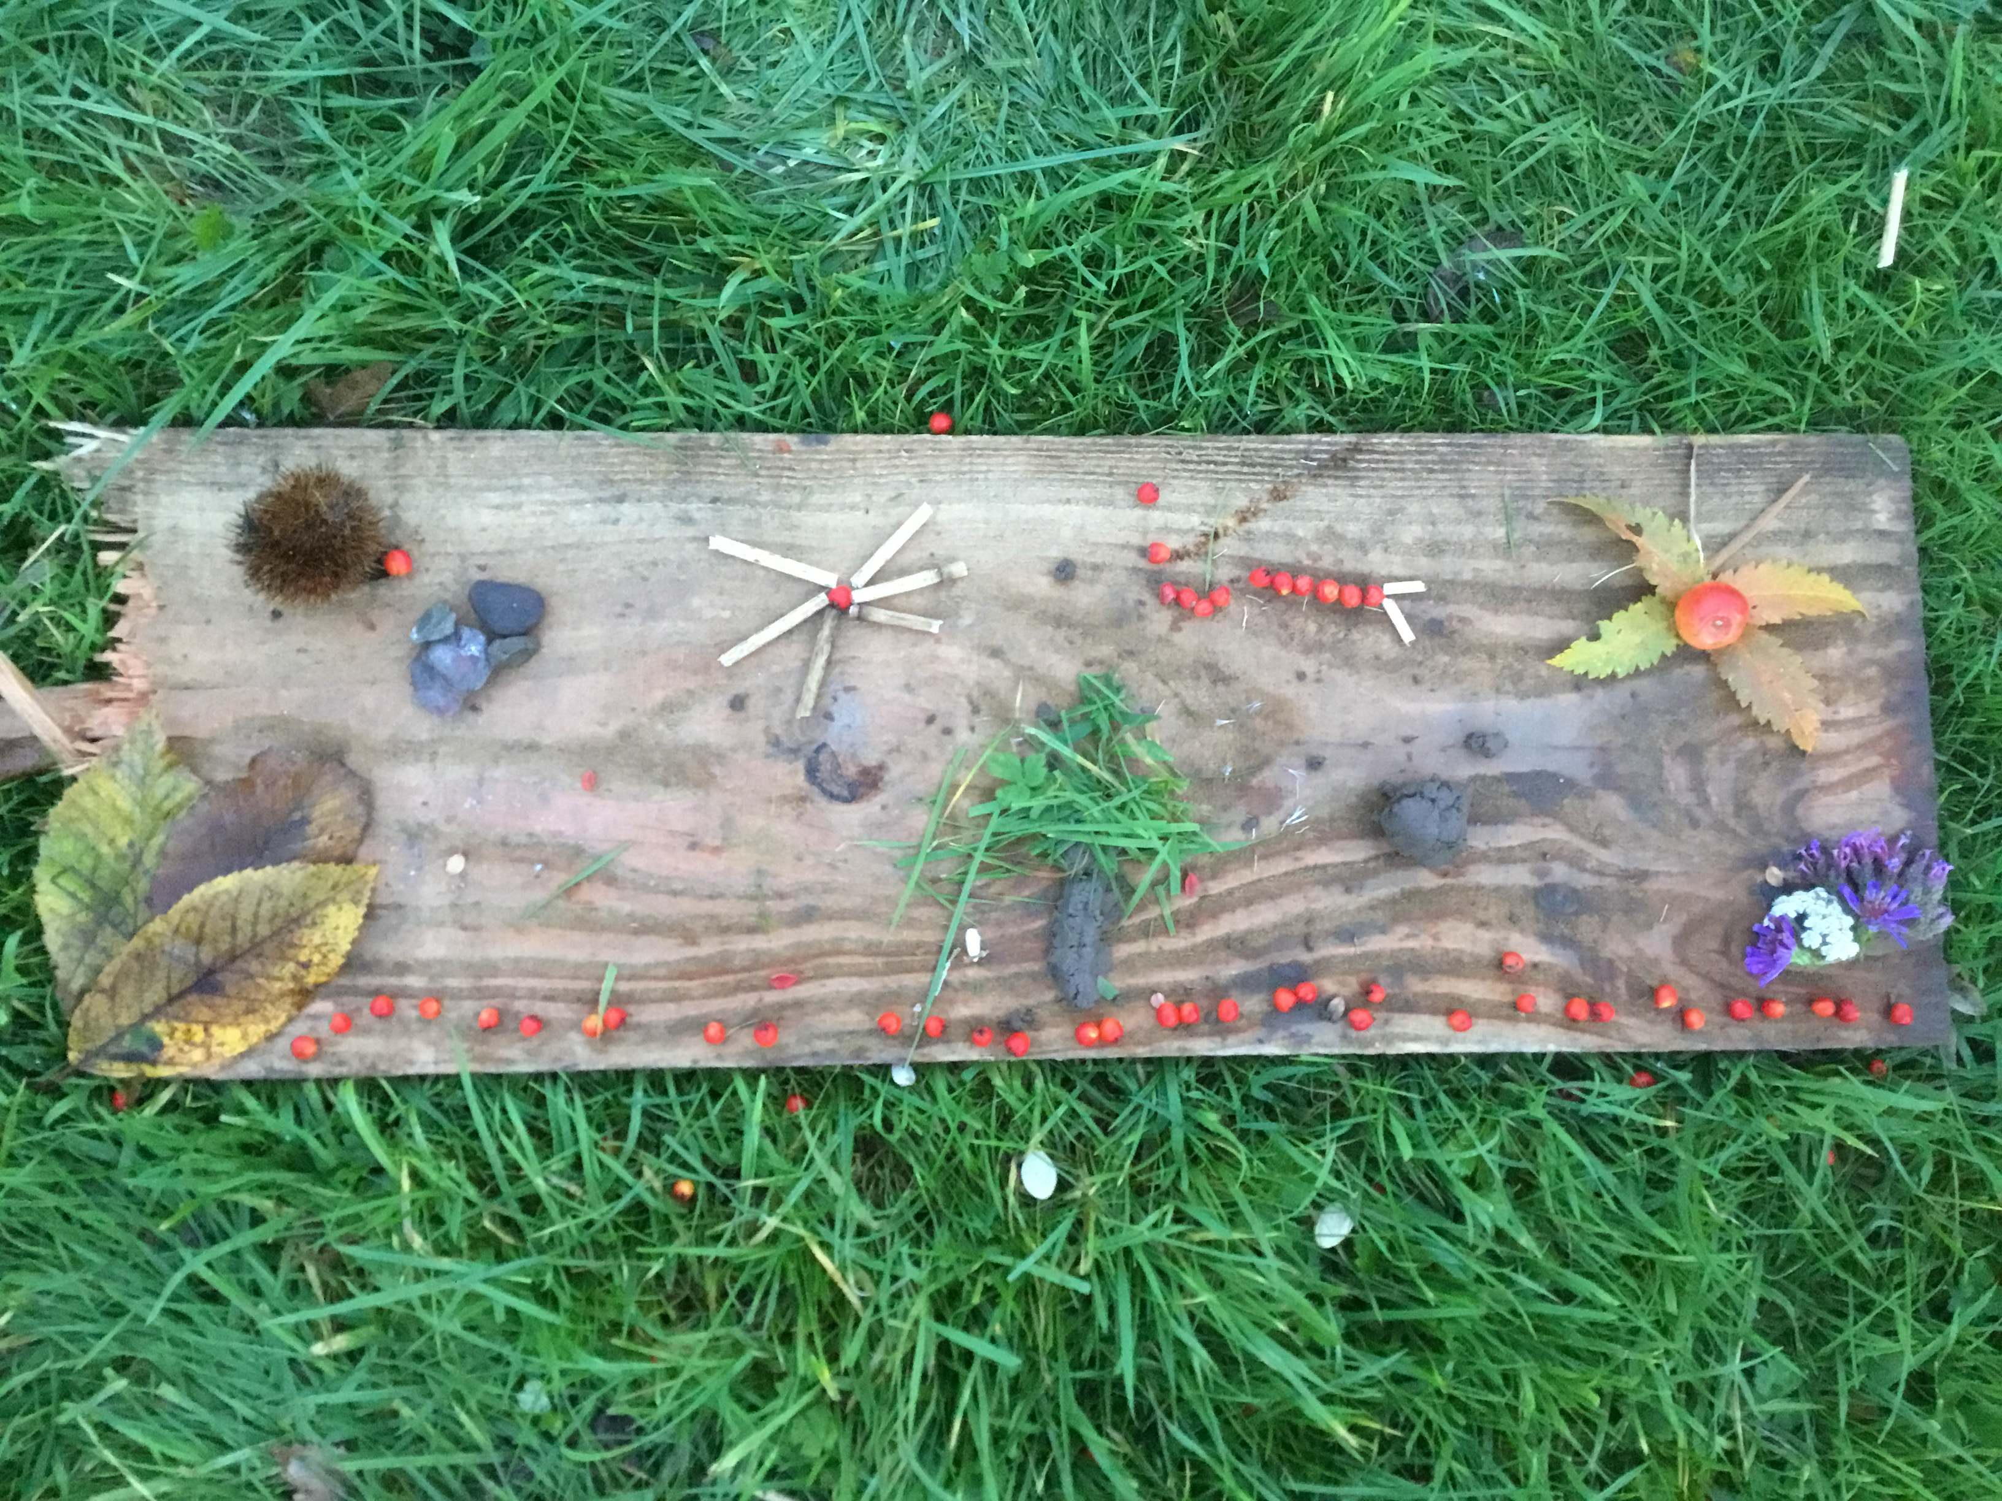
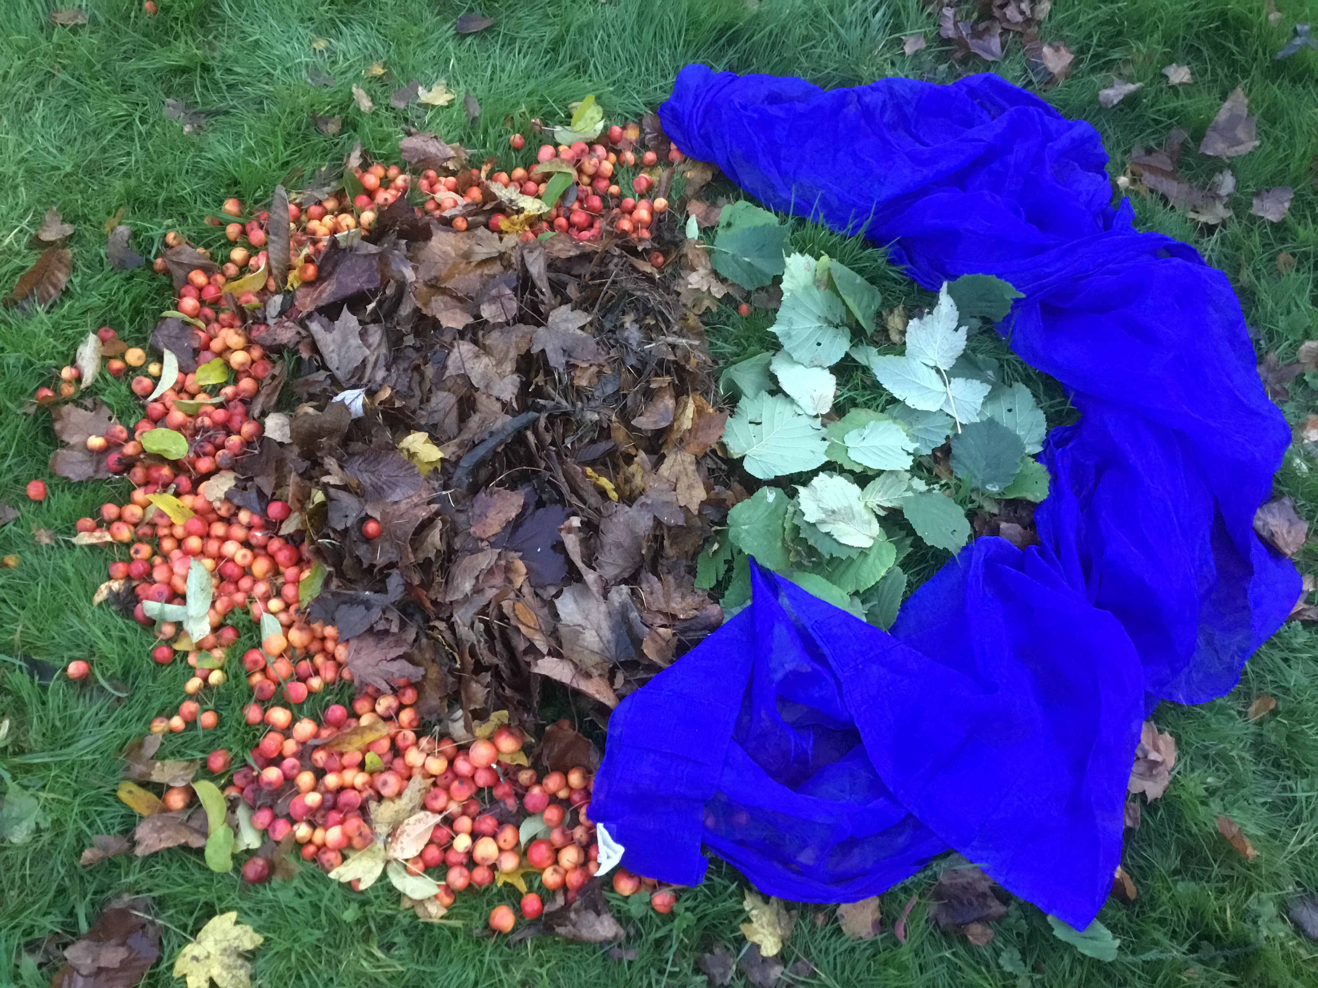
The competition entries need to be returned to Mrs Williams or
Mrs Targett (in the office) by Monday 18thJanuary.
Eco Club have been creating some models for inspiration

